Slide 1
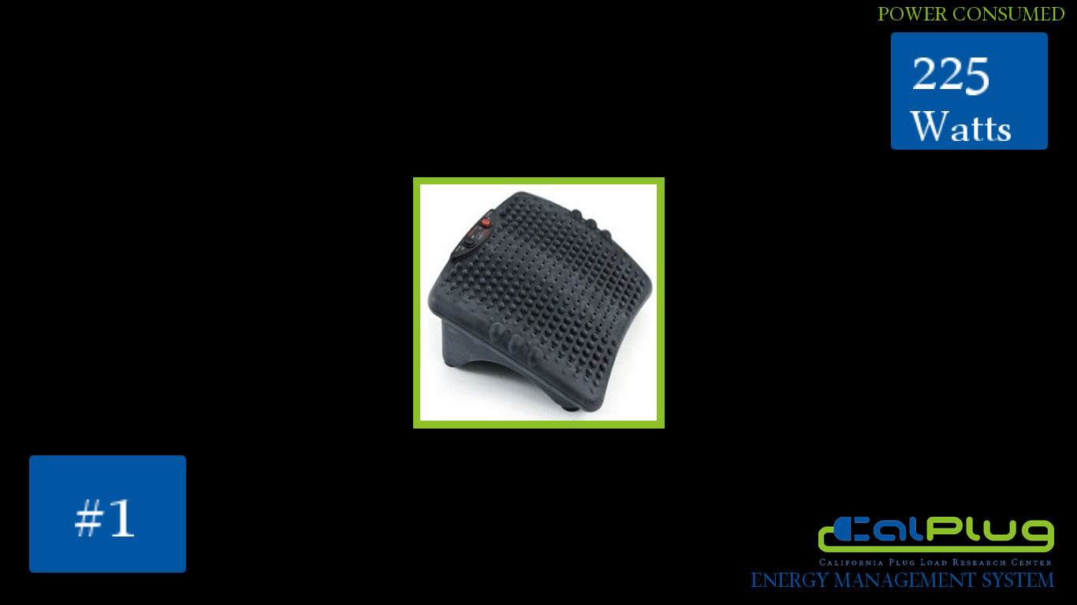
TEAM EMS PRESENTATION
By Camilo
6/3/2013

Slide 2
Active and Reactive Power
Load

Slide 3
Voltage Current
Load

Slide 4
Current Voltage Meassurements
Real Power Consumption (WATTS)
Reactive Power (VAR)
Phase Shift
Capacitor/Resistive/Inductive Circuit
Phase add linearly

Slide 5
